Slide 1
MPCA LAB MINI PROJECT
PROJECT TITLE: PASSWORD DOOR-LOCK SECURITY SYSTEM
SECTION: H2
STUDENTS NAME: SUJAY S AMBEKAR, SUMUKH J BHARADWAJ
SRN’s: PES1UG19CS516, PES1UG19CS518

Slide 2
PROBLEM STATEMENT
To make Password Based Door Lock Security System Using Arduino & Keypad. The security system also has a piezo and led for raising alarm in case of security breach

Slide 3
INTRODUCTION
Digital code lock can secure your home or locker easily.
Ensures that the door is opened only when the right password is entered
The password is of 4 characters long.
Whenever the wrong password is entered, it shows “Get Away” and there is a sound from the buzzer in order to alert the possibility of theft, thereby alerting the people around.

Slide 4
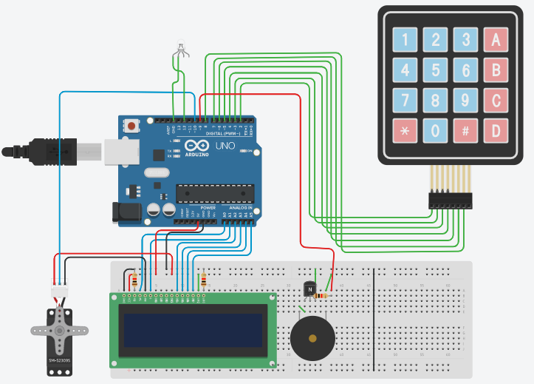
BLOCK DIAGRAM

Slide 5
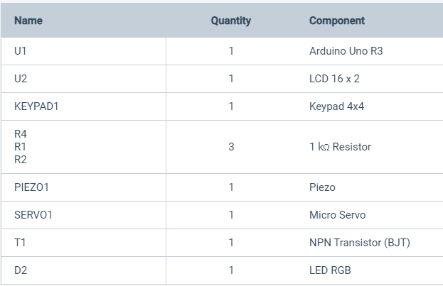
REQUIRED COMPONENTS

Slide 6
PROJECT DESCRIPTION/DEMONSTRATION
The passcode is entered through the keypad.
If the passcode is right, the servo makes a 180 degree turn, logically opening the door.
The servo remains in the same position for 5 seconds, before the relocking happens
If the passcode is wrong, the piezo buzzes and the led flashes red light
Continuous wrong attempts result in delays and waits

Slide 7
APPLICATIONS
As thefts are increasing day by day security is becoming a major concern nowadays. The password door lock security system ensures the safety of the residents of the home.
This system can also be implemented in personal lockers as well as the administrative ones such as the banks.
Security for various stores (ex : jewelry stores, etc)
Security in sensitive areas like labs where biological weapons or nuclear weapons are made.
Could be paired with CCTV to get more data.
Used anywhere like an “ALERT SYSTEM” due to the presence of buzzer.

Slide 8
REFERENCES(Website links, Books etc.)
RGB led lights sample tinkercad project for alarm system
https://www.instructables.com/RGB-LED-Color-Mixing-With-Arduino-in-Tinkercad/
How to use the keypad:
https://www.instructables.com/Using-44-Keypad-With-Arduino/

Slide 9
THANK YOU

